Slide 1
User Datagram Protocol (UDP)

Slide 2
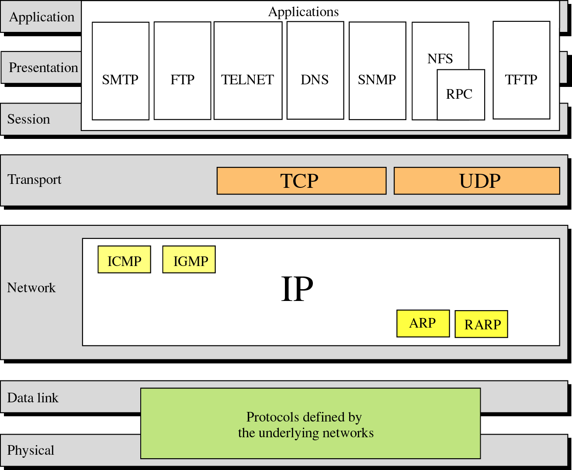
Position of UDP in the layered architecture

Slide 3
User datagram Protocol (UDP)
UDP is a transport protocol
communication between processes
UDP uses IP to deliver datagrams to the right host
Connectionless
No session is established.

Slide 4
User datagram Protocol (UDP)
Does not guarantee delivery
No sequence numbers
No acknowledgements
No flow control
No error control
Reliability is the responsibility of the application. Uses Port numbers as endpoints to communicate

Slide 5
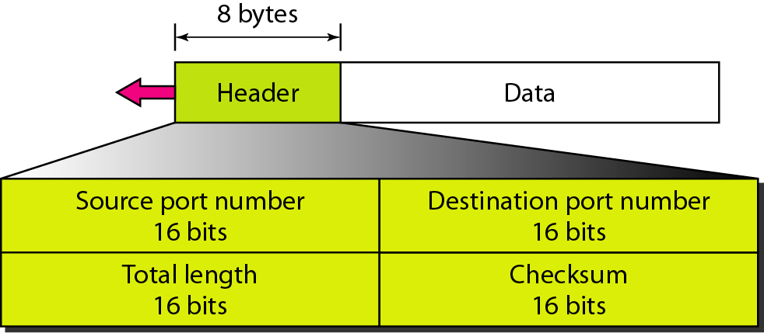
User datagram format

Slide 6
Why UDP ?
TCP is a complicated protocol involving :
Flow control
Exchange of acknowledgements
etc.,
Hence for delay sensitive applications, TCP becomes inefficient
However TCP gives utmost importance for reliability ( but at the cost of efficiency )

Slide 7
Why UDP ?
There are many applications which don’t demand reliability, but demand fast delivery
Typically audio / video streaming applications, where even loosing some bits doesn’t matter
In such cases UDP is preferred

Slide 8
UDP is suitable for a process that requires simple request –response communication with little concern for flow and error control
It is not usually used for a process like FTP that needs to send bulk data

Slide 9
UDP is suitable for a process with internal flow and error control mechanisms. For example Trivial File Transfer Protocol ( TFTP ) process includes flow and error control. It uses UDP

Slide 10
UDP is used for management processes such as SNMP

Slide 11
UDP is used for some route updating protocols such as RIP

Slide 12
Applications of UDP
DNS –Domain Name Services
SNMP-Simple Network Management Protocol
TFTP – Trivial File Transfer Protocol
RTP – Real Time Protocol

